Slide 1

Anxiety Presentation
for parents/carers of children in Primary school setting:
Nikki Brunton-Smith:
Primary Mental Health Worker
Updated September 2024

Slide 2
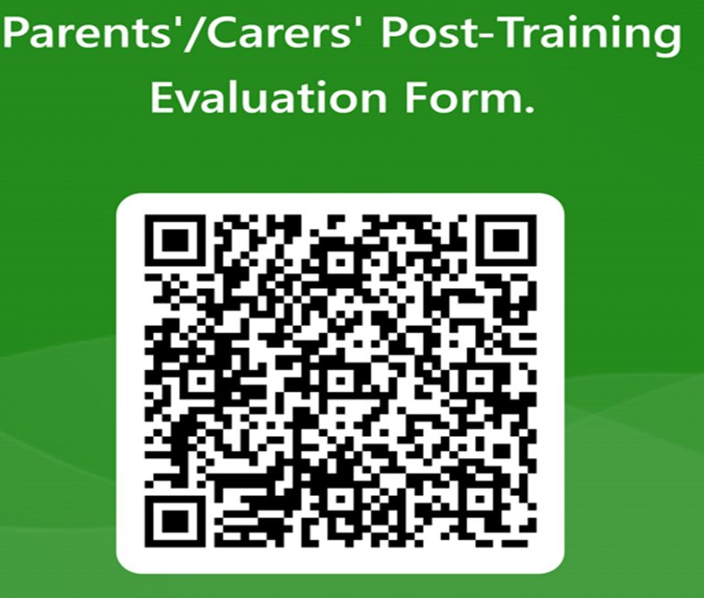
If you could spend a couple of minutes to answer these 5 short questions to provide feedback of the session, I would be grateful… ☺
many thanks

Slide 3

Aims and objectives
.To gain an understanding of what anxiety is.
.To gain understanding and knowledge of how our body works when we are anxious and why we have these bodily reactions.
.To understand what is normal anxiety.
.To gain knowledge and understanding how children can present when anxious.
.To explore how anxiety can be managed by exploring some helpful suggestions and strategies.
.To know where to go and get help further if needed.

Slide 4

What is anxiety?
Anxiety is an abnormal and overwhelming sense of apprehension and fear often marked by physiological signs (as sweating, tension, and increased pulse), by doubt concerning the reality and nature of the threat, and by self-doubt about one's capacity to cope with it’

Slide 5

Anxiety is an emotion….
Emotions are how our brains make sense of what is going on around us and move us into action.
Feeling anxious at times is normal especially when we experience something new and is part of everyday life.
You can feel anxious because you care and want to do well or when you have to do something new or different or challenging.
Learning to accept that we can feel anxious from time to time is key to learning to manage it and understand it can be a way that we grow

Slide 6
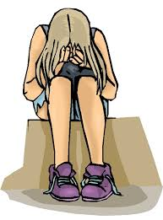
Anxiety becomes a problem when….
.. it stops your child from enjoying normal life, when it affects their school, work, family relationships, friendships and social activities…..
This is when anxiety has taken over and your child has lost control

Slide 7
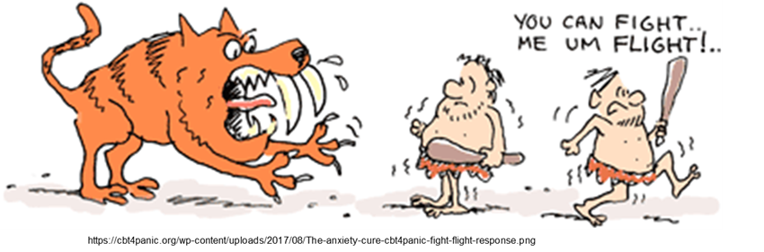
But where does anxiety come from ?
When our ancestors went out hunting for food they sometimes came across danger.
The danger would trigger an internal worry alarm system in the brain called the Fight or Flight response which is a defence mechanism wired into our brains to get us out of danger and stay safe.
Anxiety is a survival mechanism that still plays a role in modern times.
This defence mechanism is a good thing. It is there to protect you

Slide 8
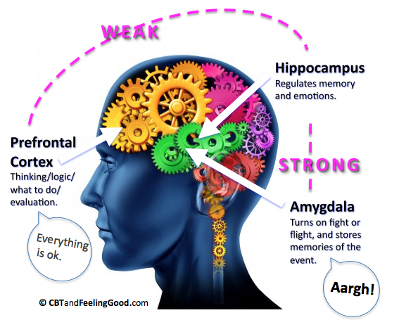
How Anxiety Works:
Your brain is made up of two main parts:
Thinking brain (logical, rational, memory)
Feeling brain (emotions)
When the worry alarm is triggered, the Emotional Brain hijacks the system and takes over making it very difficult to think straight.
It makes you act instinctively without needing to think

Slide 9
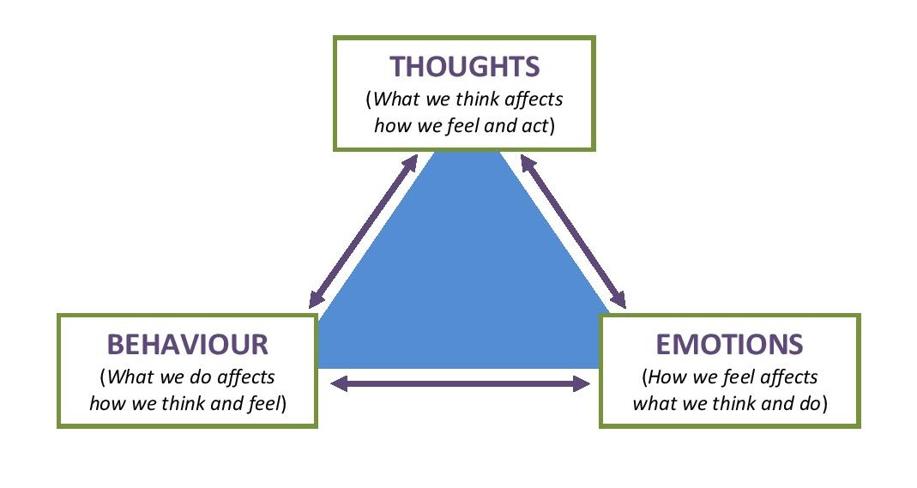
Vicious Cycle of anxiety

Slide 10
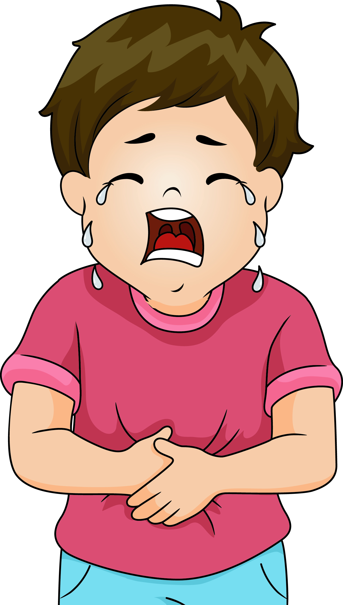
How does anxiety present?
Children are often not able to verbalise that they feel anxious, but will highlight and get investigated for physical symptoms
Common physical symptoms:
  Upset tummy/stomach pains
  Headaches
  Trembling
  Shaking
  Perspiring
  Shortness of breath
  Dizziness
  Chest pain
  Flushing
  Feeling sick
  Wanting to go to the toilet a lot
  Vomiting/diarrhoea
  Stiff muscles/tension
  Reported sleep problems.

Slide 11
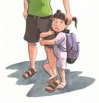
Additional signs that can be seen in the younger child
They might include….
Avoidance , crying, clingy,
school refusal
Easily upset, sensitive
Change in behaviour
Resistant to change
Melt downs, anger
Expecting the worst
May affect sleep

Slide 12
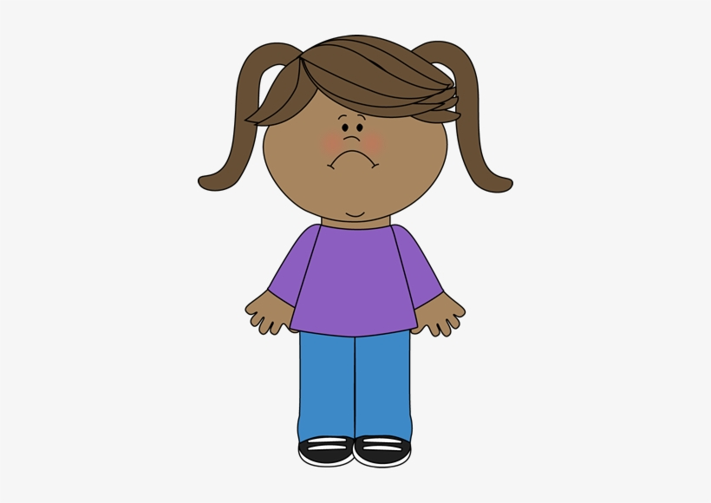
But what types of anxiety do children of this age
Experience?
.Anxiety related to trauma
.Anxiety related to neurodevelopmental issues
.Social anxiety – in older children
.Health anxiety – in older children
.General anxiety
.Separation anxiety
.Phobias
.OCD

Slide 13

Possible triggers or stress factors:
. Changes in routine- changes to school routine, how to get to school,
attending a new childminder/after school club.
. Significant events- births, deaths, moving house
. Changes in relationships- parental separation
. Even if changes are positive or exciting, the change may feel uncomfortable and precipitate an anxious response in the child
. Child attachment to parents and significant others-Anxiety as a behaviour to draw in parents/caregivers, for more care or attention

Slide 14
But why do some children develop anxiety?
Behavioural factors
The child’s anxious behaviours may have been developed by the child to cope with the feelings of anxiety associated with certain people, environments, or situations, such as attending school. For the younger child anxiety can become a mode of expression.
Genetic influence
History of panic disorder/anxiety/depression in parents >>>anxiety disorders in children
Tentative evidence!
Temperament
Anxious infants who struggle to self soothe or self regulate may have a predisposition to later develop anxiety disorders
Neurodiversity
Intolerance of uncertainty – misunderstanding others intentions ( Deliberate/accidental)
Executive function- the ability to manage some behaviours and traits ,Sensory sensitivity
Notes:
The child’s anxious behaviours may have been developed by the child to cope with the feelings of anxiety associated with certain people, environments, or situations, such as attending school. For the younger children, the behavioural component often becomes the mode of expression for the anxiety.
Genetic influence
Evidence tentatively suggests a genetic link between anxiety disorders in children and a history of panic disorder, anxiety, or depression in their parents.
Temperament
Infants with anxious temperaments, who can’t self soothe or self regulate may have a predisposition toward later development of anxiety disorders.
Misunderstanding of other people’s intentions can lead to a perception of threat.
•Difficult to distinguish between deliberate and accidental acts.
•Ambiguity perceived as threatening
•e.g. Busy school corridor, get bumped into. Interpret this as being deliberately pushed or hit.
•An awareness of the difficulty understanding other people can also lead to anticipatory anxiety about being around people, and hence avoidance
Alexithymia is characterised by difficulties identifying, expressing and feeling emotional states

Slide 15

What is a normal developmental fear in primary
aged children?
Fear of the dark.
Fear of danger.
Tests.
Peer rejection.
Insects.
Animals.
Ghosts.
.Bad people.
.Anticipating something bad will happen – .Parental separation etc.
.Being home alone.
.Sickness.
.Dying.
.School failure.
.Peer rejection.
.What others think of them.
The Red being the younger development years, and Black as they progress through Primary School.

Slide 16
Other general worries in this age group
.Separating Fantasy and Reality- nightmares/dreams seem real
.Managing Rules- ‘will I get told off if an adults thinks I’m messy?’
.Fearing the Unknown -new teacher, class trip
.Experiencing School-Related Fears- speaking aloud, not finishing work
Focus on Cooperation- more aware of others and their opinion, fragile egos get easily offended by playful taunts
.Fears of ‘individuality’ –fear of wanting to fit in and whilst being unique
.Fear of Change-changes with friends/family can feel like a loss

Slide 17

Okay…but what can I do to help ?

Slide 18

Things to avoid…..
Avoid dismissing a child’s emotions: saying ‘don’t be scared’ can lead the child to think they are wrong and bad for feeling that way
Avoid lying to avoid an emotional reaction: ‘ it won’t hurt’ when it will may lead to a sense of distrust and increase the emotional response
Avoid shaming a child for their emotions: teasing a child may lead to a sense of shame and undermines confidence…humour can be a useful distraction but not if it minimises the child’s feelings.
Avoid ignoring a child’s emotions: this may tell the child that their emotions are not important and limit opportunities to learn new ways of managing emotions
Notes:
Humour can be a useful distraction, but not if it minimises the child's feelings

Slide 19
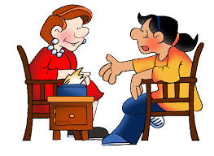
Emotional regulation…the basics
A good night's sleep- have a bedtime routine and set bedtime, avoid screens 1 hour before bed and promote quiet calm activities. Try not to talk about worries at bedtime unless you have to.
Healthy and regular meals- maintain blood sugars, avoid caffeine and too much sugar.
Be active, have lots of fun, socialise with friends but also set time to relax (try not to overschedule your child.)
Be available to talk through problems and worries, -remember to praise your child for effort, not just results.
Offer your child stability and clear behaviour boundaries,-they will feel secure.
Have good communication with your school.
Your wellbeing is vital , get some support for yourself.

Slide 20
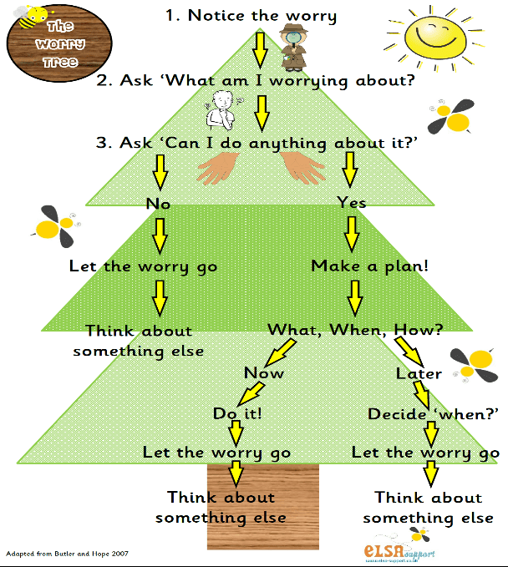
Support your child to strategize

Slide 21

Worry Time:
Allow 15 minutes per day to talk about worries. This is time together so really make the most of talking and listening about whatever worries. There should be no interruptions, no TV, no telephone, no sister, or brother wanting to play or have help with their homework.
Worry Time is the time to say whatever the child wants to say about their worries, during this time mum/ dad/ guardian should listen and try and help.
There is one important rule about Worry Time:
At all other times when your child feels that their head is full of worries, they must write them all down and pop them into a WORRY BOX, A BOOK, - ready for discussion later.

Slide 22
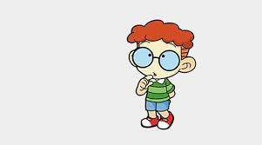
Get the child to question their anxiety thoughts
Questions to ask my thoughts and worries
1.What am I worrying about? Have I coped with this before?
2. What is the proof that this thought is true or will happen? What is the evidence that this thought is not true or will not happen?
3. What would I tell a friend if he/she had the same thought?
4. What would a friend say about my thought?
5. Am I 100% sure that this thought will happen?
6. Is this a feeling or a fact?

Slide 23

Anxious Behaviours- graded exposure work
Make a plan with the child to approach whatever makes them feel anxious gradually:
  1. Break the worry down into manageable chunks – write a list of what makes them anxious
  2. Create a hierarchy or ‘ladder’ of their anxious situations and fears, by rating how anxious they would feel (0-10) and place them in order- 10 being worst
  3. Start with no1 and practice & rehearse (repeatedly!) until the child feels less and less anxious….
  Encourage the young person to think “what did I think would happen?” e.g. the anxious thought will come true, then consider “what actually did happen?” e.g. I coped with my worry/fear….then move onto step 2 when ready…this process can take a while and you go at the child's pace, if you need to take a step back and redo the previous step until ready again
4. Reinforce the learning with praise/ rewards.
Notes:
Graded exposure work
Can talk about how this works i.e. the impact of avoidance/escape on anxiety vs. the impact of remaining with anxious situation and habituating

Slide 24
Step 1.
Break the worry down into smaller manageable steps
Notes:
The child can also rate their fear level out of 10.
One way to challenge a child’s anxious behaviours, such as avoidance, is to break it down into smaller manageable steps.
Work with your child and make a plan together.
Think about what the goal is – make this realistic. Then break it down into smaller steps, and start with a situation or thing that causes your child the least anxiety. Continue each step until they’re feeling confident / or bored.
Gradually move through more and more challenging situations
When using the stepladder approach for anxiety in children, it’s important to encourage your child by giving lots of praise for achieving each step on the ladder.
You can also use rewards as incentives for your child to move forward. Rewards might include an extra book in the evening, more cuddle time with you, or a trip to the park. Make sure the reward matches the degree of difficulty – for example, don’t give a small reward for the most difficult step.
It’s ok to go back a step, or break the steps down further if you realise they’re more challenging than first thought.
Note: the stepladder approach can be used with children of all ages. Grown-ups can use it too.

Slide 25
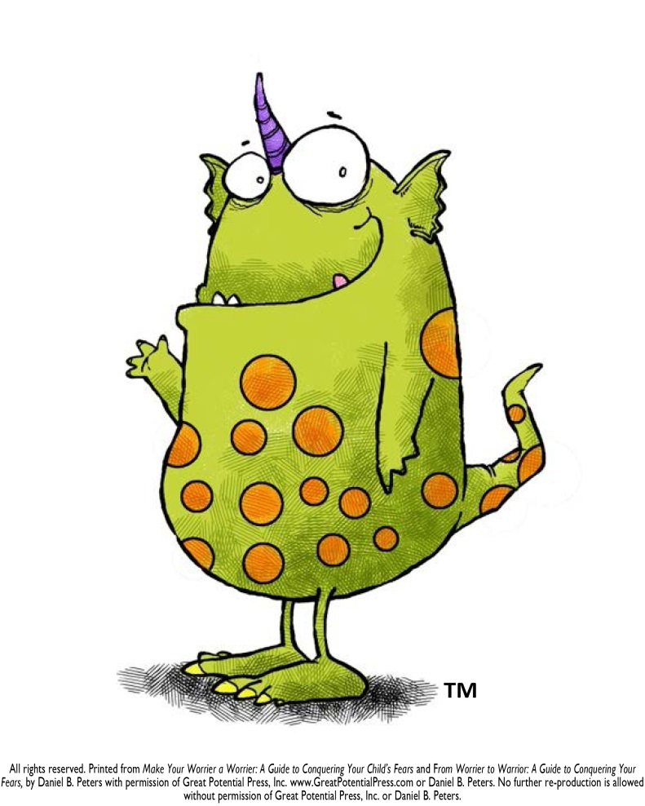
Bringing the anxieties to life
Ignoring your worries doesn’t help but bringing the worry to life and talking about it like a character can help especially for younger children.
Help the child to create their own worry monster
‘The worry monster lives in the old brain that is responsible for keeping us safe when we are in danger. Of course, sometimes he can get confused and a bit out of control. When that happens we need to stop and talk some sense into him. What do we need to tell him to help him calm down?’

Slide 26

Do monster time!
Pretend to be a monster, dress up as a monster …
Make a monster mask and use monster noises for a tickle fight …
Colour in a print out of a monster … change the picture so that the monster looks silly ...
Make up a silly song about monsters …
Cut up a picture of a monster and stick it back together so it looks silly …
The aim of this strategy is to take away the scariness of monsters
Schedule daily monster time for at least 15 minutes per day …

Slide 27
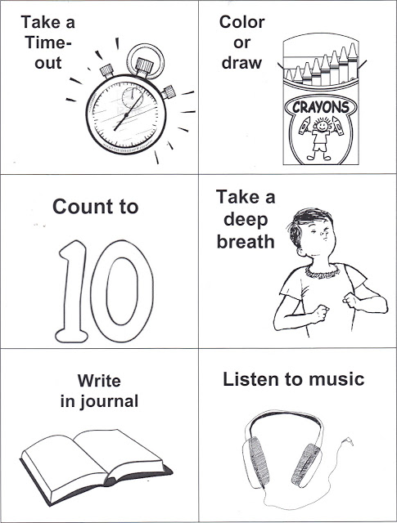
Make a checklist
What do trained pilots do when they face an emergency? They refer to a checklist. Even with years of experience a pilot will refer to a checklist because when you are faced with danger you cannot think straight.
When we feel anxious, we can get overwhelmed and not be able to think clearly.
Drawing up a checklist of things that you know help you to calm down can be really useful.
You can try out new techniques and evaluate how helpful they are for reference.

Slide 28
Other calming strategies
Reducing worry feeling techniques: -
‘Breathe in for 7 …out for 11’.
‘5 things you can see, 4 things you can hear, 3 things you can touch,2 things you can smell, 1 slow breath in and out’.
‘Square breathing’
‘Find items A, B, C etc’
Mindfulness activities: Breathing in as though to smell of the flower, blowing out to blow out a candle, taking a walk-in nature and noticing the present moment
Think what works for you when you are stressed/anxious?

Slide 29
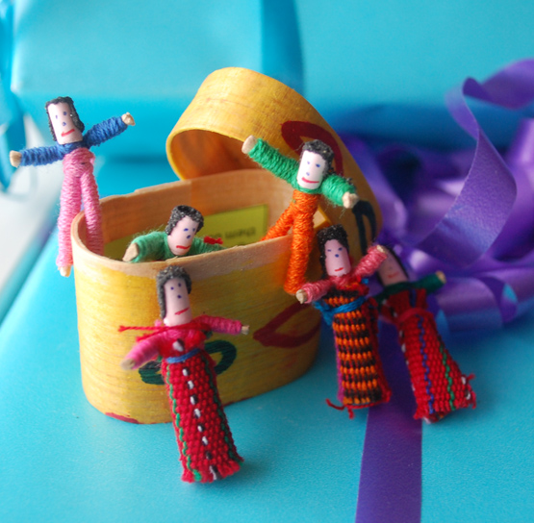
Suggestions to help challenge worries
THOUGHT DIARY – write down worries and fears and contain to a book you can just shut and close off your worries and fears
CHALLENGE WORRIES Make a list of all the things that worry you. Write positive challenging statements next to your worry thoughts – “What would you tell your best friend to do”; is it a ‘fact or a belief?’
FINDING SOLUTIONS using the worry tree
TALK to someone – a problem shared is a problem halved.
Tell the Worry Monster that he cannot beat you!!

Slide 30
Other ways to help with Worries
Writing out/drawing out the worry
Anxious thoughts make us feel powerless, but talking back to anxious thoughts gives us control over the situation
  Talk back to the worry – telling the worry to GO AWAY! or “you are not helping me solve a problem right now”
  Use puppets/stories to create a character – super hero or self to challenge worries – make a script
  Thought stopping - saying STOP! This technique interrupts the anxious flow
  Put a big full stop on the end of the worry ……FULL STOP!
One positive from today was….help the young person identify a positive for the day.
Notes:
Like worry work mentioned previously – write out worries and screw it up/throw away.
Helpful distraction i.e. focusing on something else which is more in line with their interests/goals and can move away from worrying (especially when cannot change worry – worrying about future, about things which haven’t happened yet and cannot disprove
Any method of expressing their thoughts, by writing, drawing etc is helpful to externalise those worries.
Anxious thoughts make us feel powerless, but talking back to anxious thoughts gives us control over the situation.
Tell that worry to ‘go way’ ‘stop’ or end.
Helping a young person to identify a positive from the day can help keep their mood up and recognise their achievements no matter how small!

Slide 31
STOPP Technique

Slide 32
Building A Coping Kit/Toolbox
  . Have a list of strategies to use in a moment of anxiety
  . Have a list/box which includes a checklist covering different, useful strategies
    Inside could include a stress ball, a glitter ball, a calming picture, age-appropriate instructions for deep breathing, colouring kit, etc.
    Home could have a duplicate box.
  . The child could try to use this first before involving an adult to encourage age-appropriate independence

Slide 33
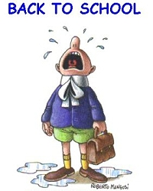
But what about Emotionally Based School Non-Attendance (EBSNA)?
School avoidance is not a formal psychiatric diagnosis
EBSNA can be defined as :Difficulty attending school due to emotional factors which can manifest as anxiety and, in some cases, result in prolonged periods of absence from school.
: Affects approximately 1-2% of the school population
: Most common in adolescence
: Equally common in males and females
: Not related to socioeconomic status
: Can be gradual or sudden

Slide 34
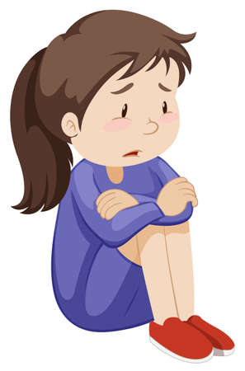
Four main reasons for school avoidance
Avoiding negative emotion: Avoiding uncomfortable feelings brought on by attending school ( social interactions, friendships issues, conflict with teachers).
Situation avoidance: Escaping particular situations that might be stressful, cause anxiety or fear (e.g. academic demands, social pressures, taking part in activities such as drama/PE, aspects of the school environment).
Attachment seeking: Reducing separation anxiety, gaining relational input from and/or spending more time with significant others
Tangible reward: Spending more time out of school as it is more fun/stimulating

Slide 35

The Push and Pull factors
The Push effect
.Is the child being pushed out of school because the environment feels threatening and unsafe?
.Is the young person struggling academically in one or more of their subjects?
.Is the young person confident and socially integrated with strong friendships and alliances?
.Is the young person different from most other young people, for example from a different ethnic or religious group?
.Does the child have an obvious or hidden disability?
.Is the child or young person suffering from a physical illness?
.Could the child be a victim of bullying, teasing or another form of abuse?

Slide 36

The Pull effect
.Is the child being pulled home out of fear of leaving a parent or because home feels safe?
.Have there been any significant life changes or stresses affecting the young person? For example: - Has there been significant loss or bereavement such as parental separation, the death of a close family member or friend, a change of school or move of house?
.Is the parent unwell?
.Any safeguarding concerns?
.Is the home environment a fun place to be with no rules/limits/boundaries?

Slide 37

What parents can do ?
Remain calm.
Ask questions: why is my child finding going to school difficult?
Look for solutions; what can I do to support my child in feeling more positive about going to school?
Acknowledge that you can see how they are feeling
Validate their feelings: Explain to them that you understand how upset they feel, but that experience tells us that this upset will settle fairly quickly if they attend school consistently
Contain: talk to the child in a calming and soothing tone of voice.
Distract: re-direct their attention to another activity such as focusing on their breathing, doing a task
Reflect: once the child has had time to calm and settle down, talk through the situation with the view of helping the child to find a solution/ strategy that helps them to contain their feelings of anxiety.

Slide 38
Things Parents can do….
Talk to the child’s teacher
Draw up a plan together to support the child involving the child – remember to consider any triggers (The physical environment e.g. toilets, corridors, assembly hall…Times of the day or social interactions e.g. arriving at school, play and break times, lining up to go into school or classroom, lunchtimes, going home, changing for PE…Particular lessons or activities within lessons e.g. writing, working as part of a group, reading aloud, verbally answering a question)
Devise a gradual return to school step programme
Stick to the plan- Encourage the child to attend school every day no matter how hard it is for them
If the child falls behind academically think about how to support them in their learning
Take small steps to push the child out of their comfort zones- remember to face the fears and to give praise.

Slide 39
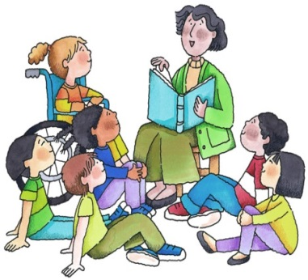
School strategies
Provide routine
Connection with staff
Providing clear and concise communication
Visual timetables
Plan and Prepare for transitions and change throughout the school day
Providing opportunities for the child to take part in meaningful activities that promote creativity such as music and art
Lunchtime club
Peer mentors
Circle of friends
Safe zone
Time out cards
Worry time
Incentives and rewards in the form of praise/tokens
For child to be aware of how to report bullying/ other issues

Slide 40
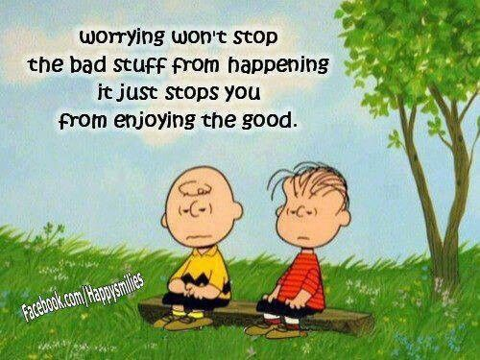
Summary
Anxiety is normal and a small amount is necessary for us all to function well.
Feel the fear and face it anyway, encourage brave behaviour.
Encourage helpful coping strategies : they WILL work, just keep practicing
Have a ‘calm plan’ prepared. Acknowledge, contain and help problem solve
Enjoy life; do not waste your life worrying it away!
Know where to go to ask for help if you need it

Slide 41
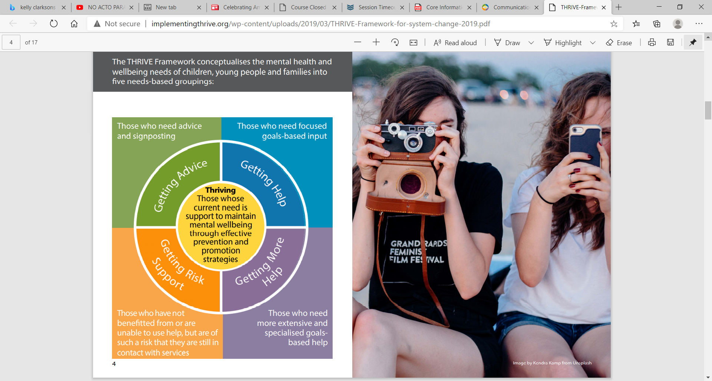
Surrey’s emotional wellbeing and mental health service for children and young people
Please do look at our new website: https://www.mindworks-surrey.org/ There is information for children, young people, families and carers about services, advice and resources, including how to ask for help in a crisis via the 24/7 Crisis Line.

Slide 42
Mindworks support Lines:
ND Line A free out-of-hours phone line provides advice to parents and carers who are struggling with behaviours or difficulties which could be related to neurodevelopmental need, such as autism or ADHD.
Our skilled and friendly advisers will talk carers and families through ways of calming down difficult situations and remind them of their coping strategies.
It runs from 5pm until 11pm, seven days a week, 365 days a year .Please call 0300 222 5755.
Crisis Line If you are worried about yourself, a friend, or your child or young person, please call our 24/7 mental health crisis line free on 0800 915 4644. It’s open all day and all night, seven days a week.
You can talk with a trained call handler who will provide advice, support and signposting to a range of community services. The crisis line is available for children and young people from the age of six. It can be used by those
who are already receiving mental health services, and also by those who are not. No formal request for support is needed…..Or in the case of an emergency, call 999 or 112 from a mobile.

Slide 43
Websites
Resources for anxiety
www.youngminds.org.uk Young Minds is a UK national charity for children and parents of children with mental health problems. They offer information and advice to parents, young persons and professionals about mental health problems, how to cope with mental health problems, best practice, current campaigns, and information about child and adolescent mental health services.
www.ocdaction.org.uk The OCD Action Help and Information Line: 08453906232 (UK) The website gives advice and information about OCD and related conditions.
https://www.anxietycanada.com/- free online resources
IHeartCBT - Parents, Mental Health Resources (weheartcbt.com) - 3-part session to managing your child’s worries.
School Anxiety and Refusal | Parent Guide to Support | YoungMinds
Emotionally Based School Non-Attendance (EBSNA) | Surrey Local Offer
Website with lots of different story books for anxiety
https://www.littleparachutes.com/

Slide 44
Websites, Courses and Further Resources
Find an adult learning course - Surrey County Council (surreycc.gov.uk) Surrey Adult Learning Online Courses- Covering topics such as anxiety, understanding your child’s behaviour, self-esteem, resilience, masking and neurodiversity, child to parent violence, behavioural strategies, friendship issues, LGBTQ.
Stepping Up For Autism course- provided by the National Autistic Society. Surrey County Council - Family information directory (surreycc.gov.uk)- please see website for links to local support page.
Positive Parenting Service- Supporting Parents with Children with ADHD- provided by Barnardos Surrey Positive Parenting Service | Barnardo's (barnardos.org.uk)

Slide 45
Book References
Overcoming Your Child’s Fears and Worries a self-help guide to using CBT Techniques by Cathy Creswell and Lucy Willetts
Overcoming Your Childs Shyness and Social Anxiety a self-help guide to CBT techniques by Cathy Creswell and Lucy Willetts
Relax Kids Aladdin’s Magic Carpet by Marneta Viegas
The Whole Brainchild by Dr Daniel Siegel
The Brain by David Eagleman
Frazzled By Ruby Wax
The Chimp Paradox by Steve Peters
The Huge bag of worries by Virginia Ironside
What To Do When You Dread Your Bed by Dawn Huebner.
Facing Mighty Fars About Throwing up Buy Dawn Huebner
Helping Your anxious Child by Rapee, Spence, Cobham and Wignall
What To do When You Worry Too Much – A Kids Guide To Overcoming Anxiety
By Dawn Huebner
What To Do When You Grumble Too Much – a Kids Guide to Overcoming Negativity
By Dawn Huebner
1,2,3 Magic by Thomas Phelan book/DVD resource which can help remind everyone of useful age-appropriate strategies when trying to encourage young people to make wise choices in their behaviour especially useful for parents of children aged 2 to 12; learning to manage troublesome behaviour, encourage good behaviour, and strengthen the parent-child relationship

Slide 46
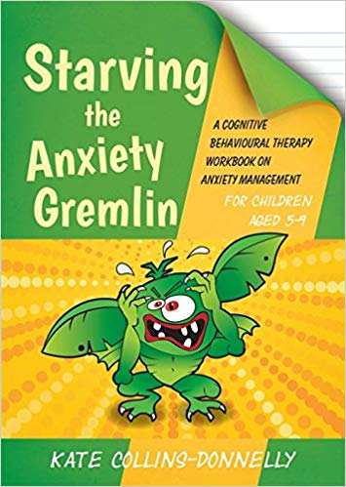
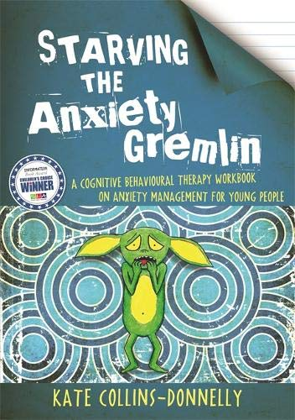
Book References
A kid’s Guide to overcoming OCD (What to do Guide for kids) by Dawn Huebner “This story guides children and their parents through the cognitive-behavioral techniques used to treat Obsessive Compulsive Disorder. Revealing OCD in a whole new light, this interactive self-help book turns kids into super-sleuths who can recognize OCD's tricks. Engaging examples, activities, and step-by-step instructions help children master the skills needed to break free from the sticky thoughts and urges of OCD, and live happier lives. This is a complete resource for educating, motivating, and empowering children to work toward change”.

Slide 47
Resources for Parents
Cruse Bereavement care Helpline: 0808 808 1677 Website: https://www.cruse.org.uk/
Mind Matters Surrey IAPT (Improving Access to Psychological Therapies) is a talking therapy service for adults (18+) registered with a GP in Surrey. They provide quick and easy access to talking therapies, https://www.mindmattersnhs.co.uk/
Samaritan helpline - Whatever you're going through, Samaritans will face it with you. Open 24 hours a day, 365 days a year. Call 116 123 for free https://www.samaritans.org/
https://www.qwell.io/ Online emotional wellbeing and mental health support.

Slide 48


Slide 49
If you could spend a couple of minutes to answer these 5 short questions to provide feedback of the session, I would be grateful… ☺
many thanks

